Slide 1

Feature Detection in Fundus Image for Medical Diagnosis
Team 6 from IS04, PSUPR

Slide 2
Our Team
Zhong Xiaohui
Kelvin Li Zhenghao
Zheng Xiaolan
Lim Chang Siang
Team Lead
Business Case
UI / UX designer
Machine Learning Engineer
Product Owner
Domain Expert
Data acquisition
Machine Learning Engineer
Technical Writer
Data analysis
Data processing
Machine Learning Engineer
Technical Lead
Full Stack Developer
Machine Learning Engineer

Slide 3
Goals and Vision
Goals
Vision
To deliver a minimal viable product for feature detection of fundus images
The fundus feature detection tools can support the development of other AI-based diagnostic support system for use in clinics and hospital

Slide 4
Global disease burden
2.2 billion people with a near or distance vision impairment
At least 1 billion of these cases could have been prevented, or has yet to be addressed
In low-income and middle-income regions is estimated to be 4 times higher than in high-income regions
Population growth and ageing are expected to increase the risk

Slide 5
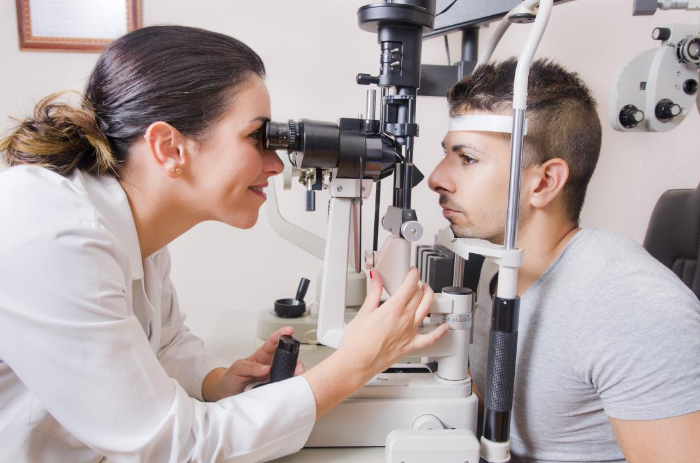
Problem Statement
Ophthalmology is high volume medical specialty that requires specialized physician domain knowledge and expensive equipment
Accentuated by an increased eye care burden from an ageing population

Slide 6
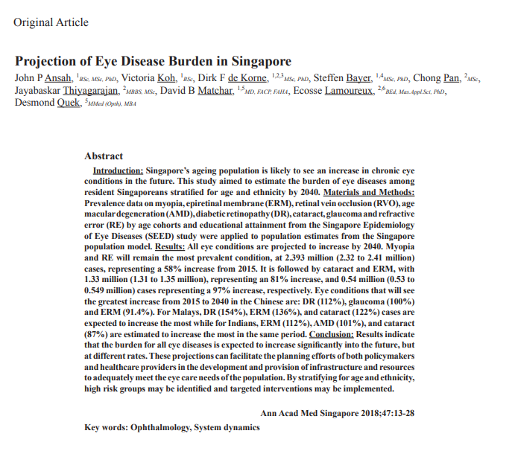
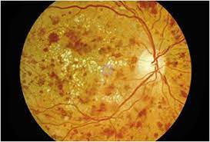
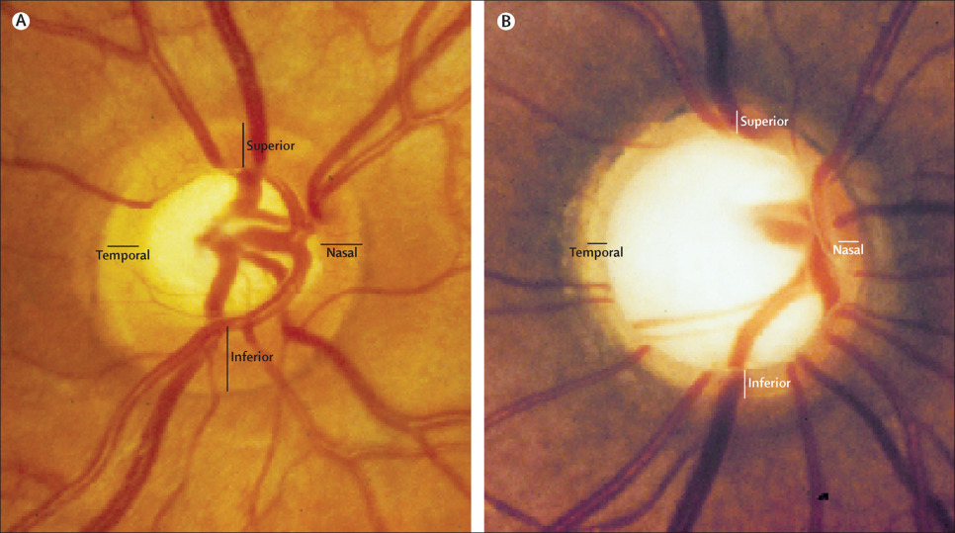
Eye burden in Singapore

Slide 7
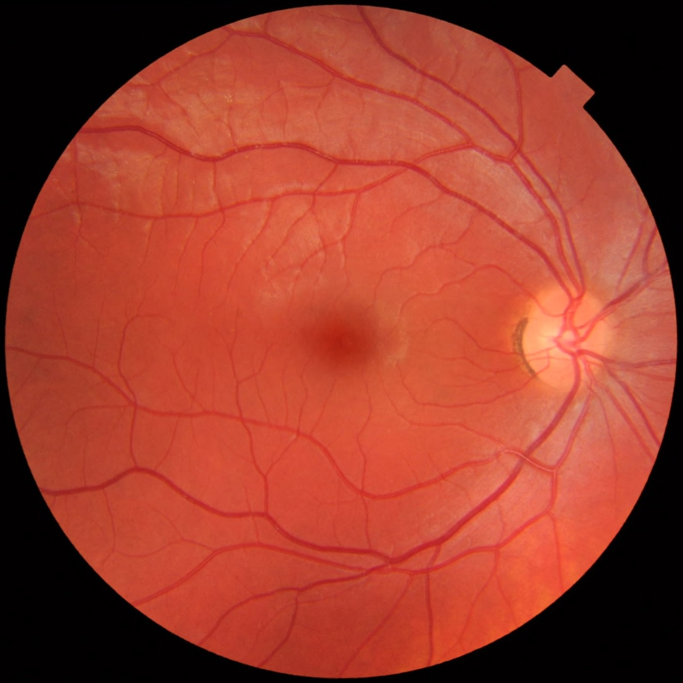
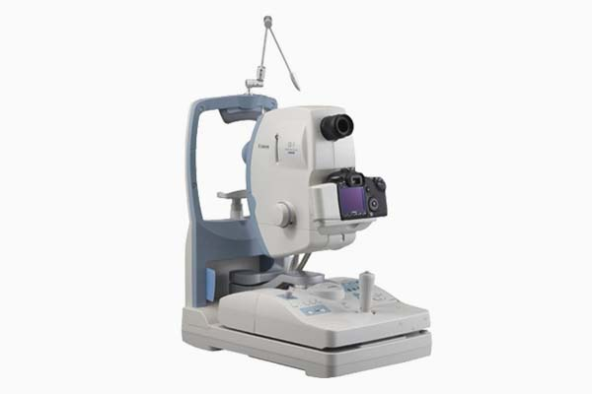


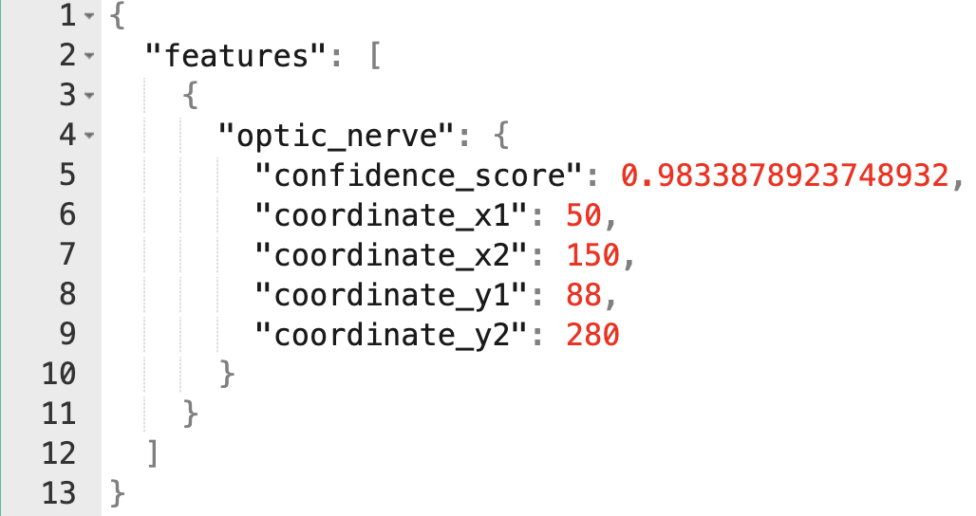
Goals
To deliver a minimal viable product for feature detection of fundus images
BV (0.7)
Optic Nerve (0.95)
Lens (0.8)
BV (0.7)
Digital Retinal Camera
Web Application
Pattern Recognition System
BV (0.7)
Feature Annotation

Slide 8
Goals
Input
Segmentation
Class Label
Class A
Class B
Class C
Class D
Class E

Slide 9
Project Plan

Slide 10
Software Development Process
Data acquisition
Obtain full fundus image from public domain, legally
Approaches
Data creation + augmentation
Create a set image subset of various fundus image feature
Random Forest Classifier
SVM
K-NN
LDA
Clustering Methods
Deep Neural Networks
Develop ML model for pattern recognition
Ensure that the system met the needs and requirement of Product Owner
Validate with Product Owner
Revise and Improve
Integrate ML/AI system into a software application for user to interact with the ML system
Software integration
Delivery
Delivery of final ML system and Project Report

Slide 11
Data and Tools Requirement
Training and Test data availability
Datasets | Data size | Source | Available
Rotterdam Ophthalmic Data Repository | 70 | rodrep.com/data-sets.html | Yes
EyePACS | 35,126 | Public Domain¹ | Yes
ORIGA-650 | 650 | Public Domain² | Yes
COCO dataset | 330k | cocodataset.org | Yes
ImageNet | 14 million | image-net.org | Yes
References
JAMA. 2016;316(22):2402-2410. doi:10.1001/jama.2016.17216
Comput Math Methods Med. 2019; 2019: 8973287. doi: 10.1155/2019/8973287

Slide 12
Data and Tools Requirement
Machine Learning tools and techniques used
Tools
Techniques
Tool | Purpose | Available
ImgLabel | Label training data | Yes
Roboflow | Data preprocessing | Yes
Scikit-Learn | Machine Learning Library | Yes
Keras | Deep Learning Library | Yes
PyTorch | Deep Learning Library | Yes
Python | Programming Language | Yes
Google CoLab | Training Models and project collaboration | Yes
Random Forest Classifier
SVM
K-NN
LDA
Clustering Methods
Deep Neural Networks
Transfer Learning
InceptionV3
ResNet
AlexNet
VGG
YOLO

Slide 13
Data and Tools Requirement
Software Development tools and availability
Tool | Purpose | Available
Visual Studio Code | Development Environment | Yes
Python / JavaScript | Programming Language | Yes
Angular 8 | Web UI Framework | Yes
Django | Python-based Web Server | Yes
Jetty 8 | Web Container Server | Yes
Hardware requirements and availability
Tool | Purpose | Available
Personal Laptop | Development and Demonstration | Yes

Slide 14
Progress Overview
Data sourcing
Data preparation
Data labeling
UI Design
Data pre-processing
Build prediction model
Develop bbox approach
Attempt transfer learning approach

Slide 15
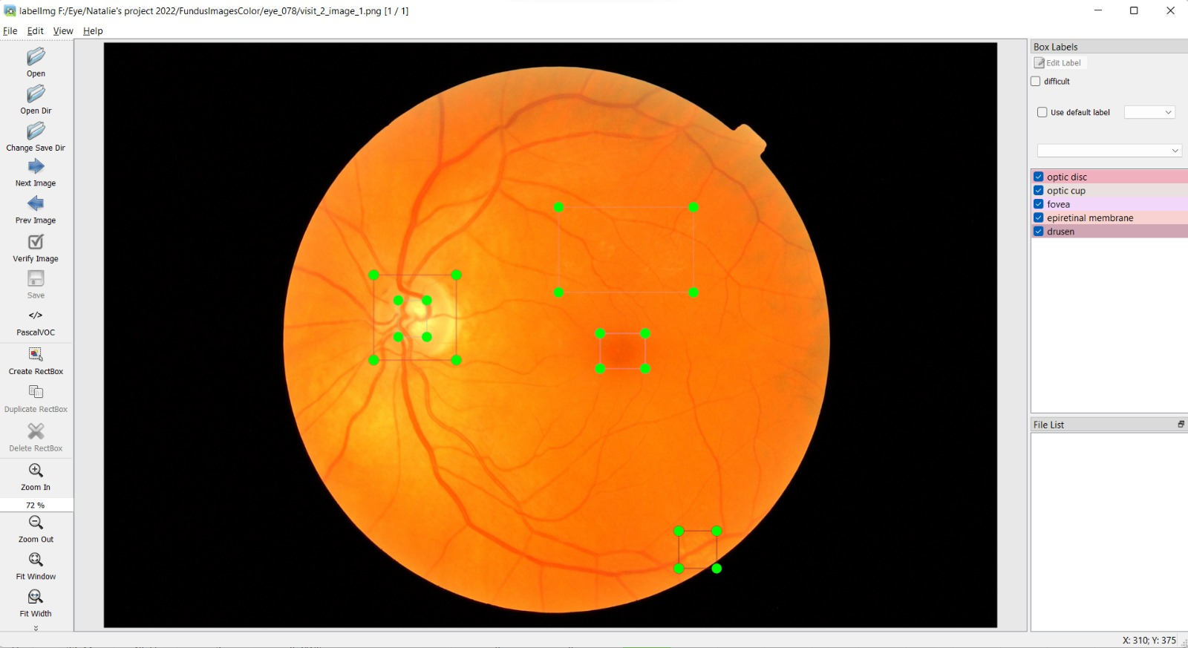
Progress Update
Use LabelImg to label data for object detection
Labelled 80 images
LabelImg: https://github.com/heartexlabs/labelImg

Slide 16
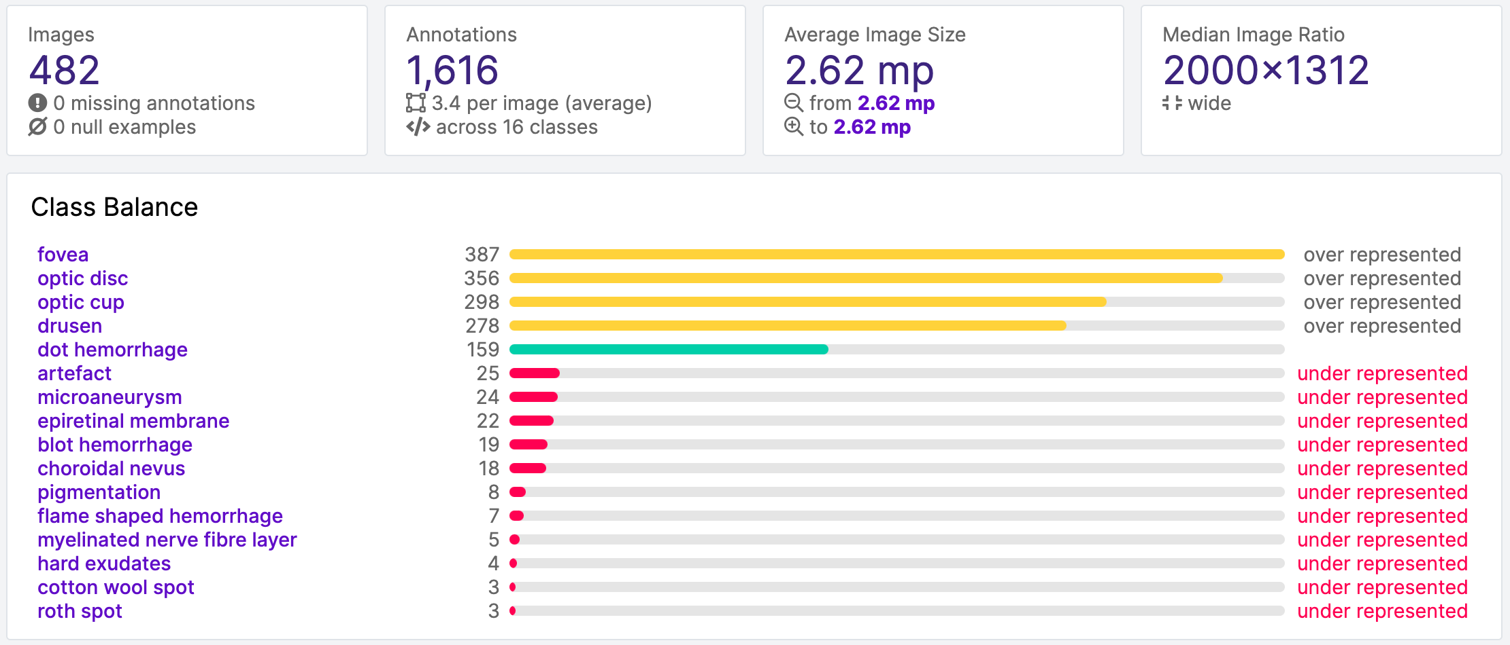
Progress Update
Data acquisition and data health check
Fundus image acquire from public data set (Rotterdam Eye)
Manual labelling of data by domain expert (Kelvin Li)
A total of 482 images and 1616 annotations
Unbalanced data set
Fovea, optic disc, optic cup, drusen, dot hemorrhage are the most common class

Slide 17
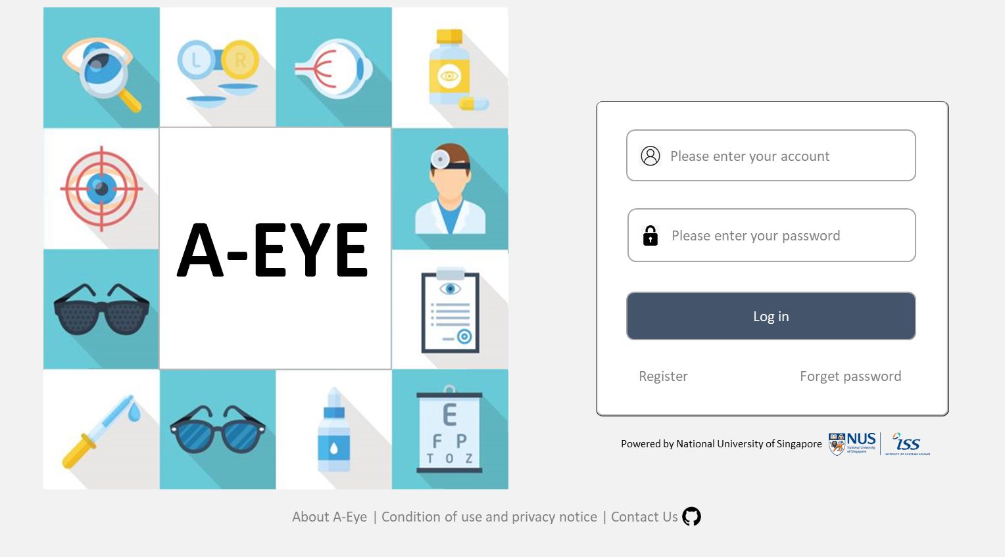
Progress Update

Slide 18
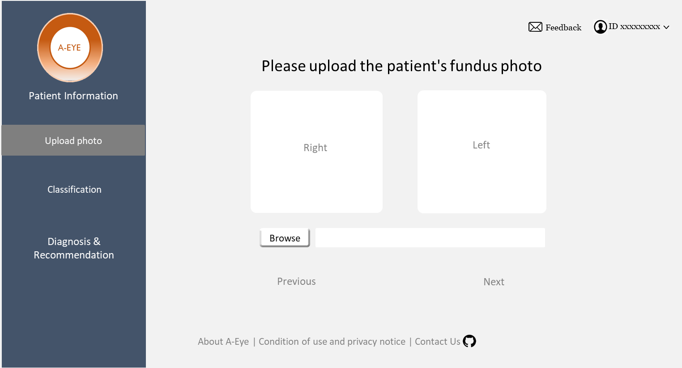
Progress Update

Slide 19
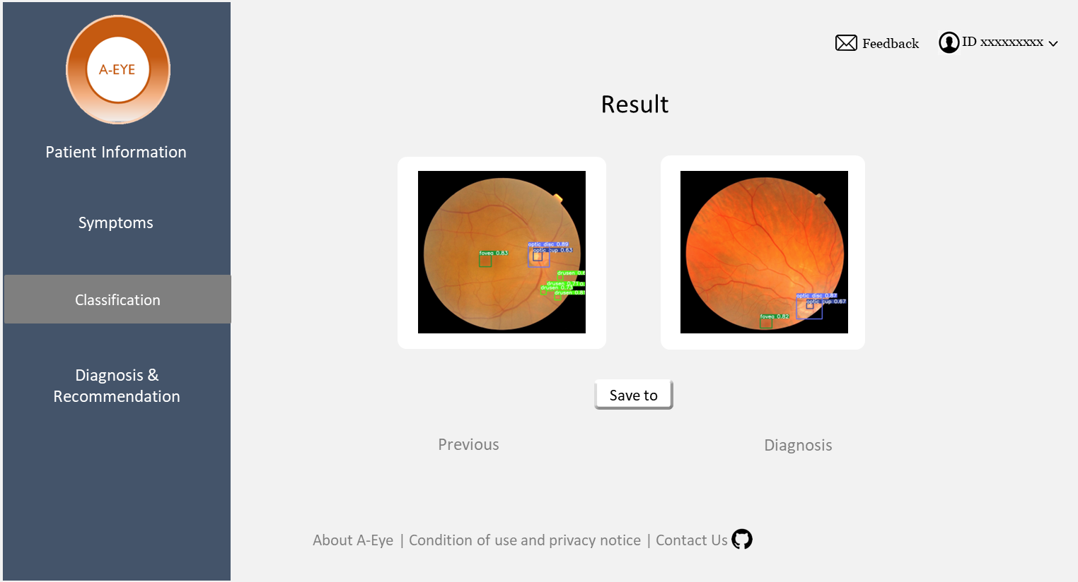
Progress Update

Slide 20
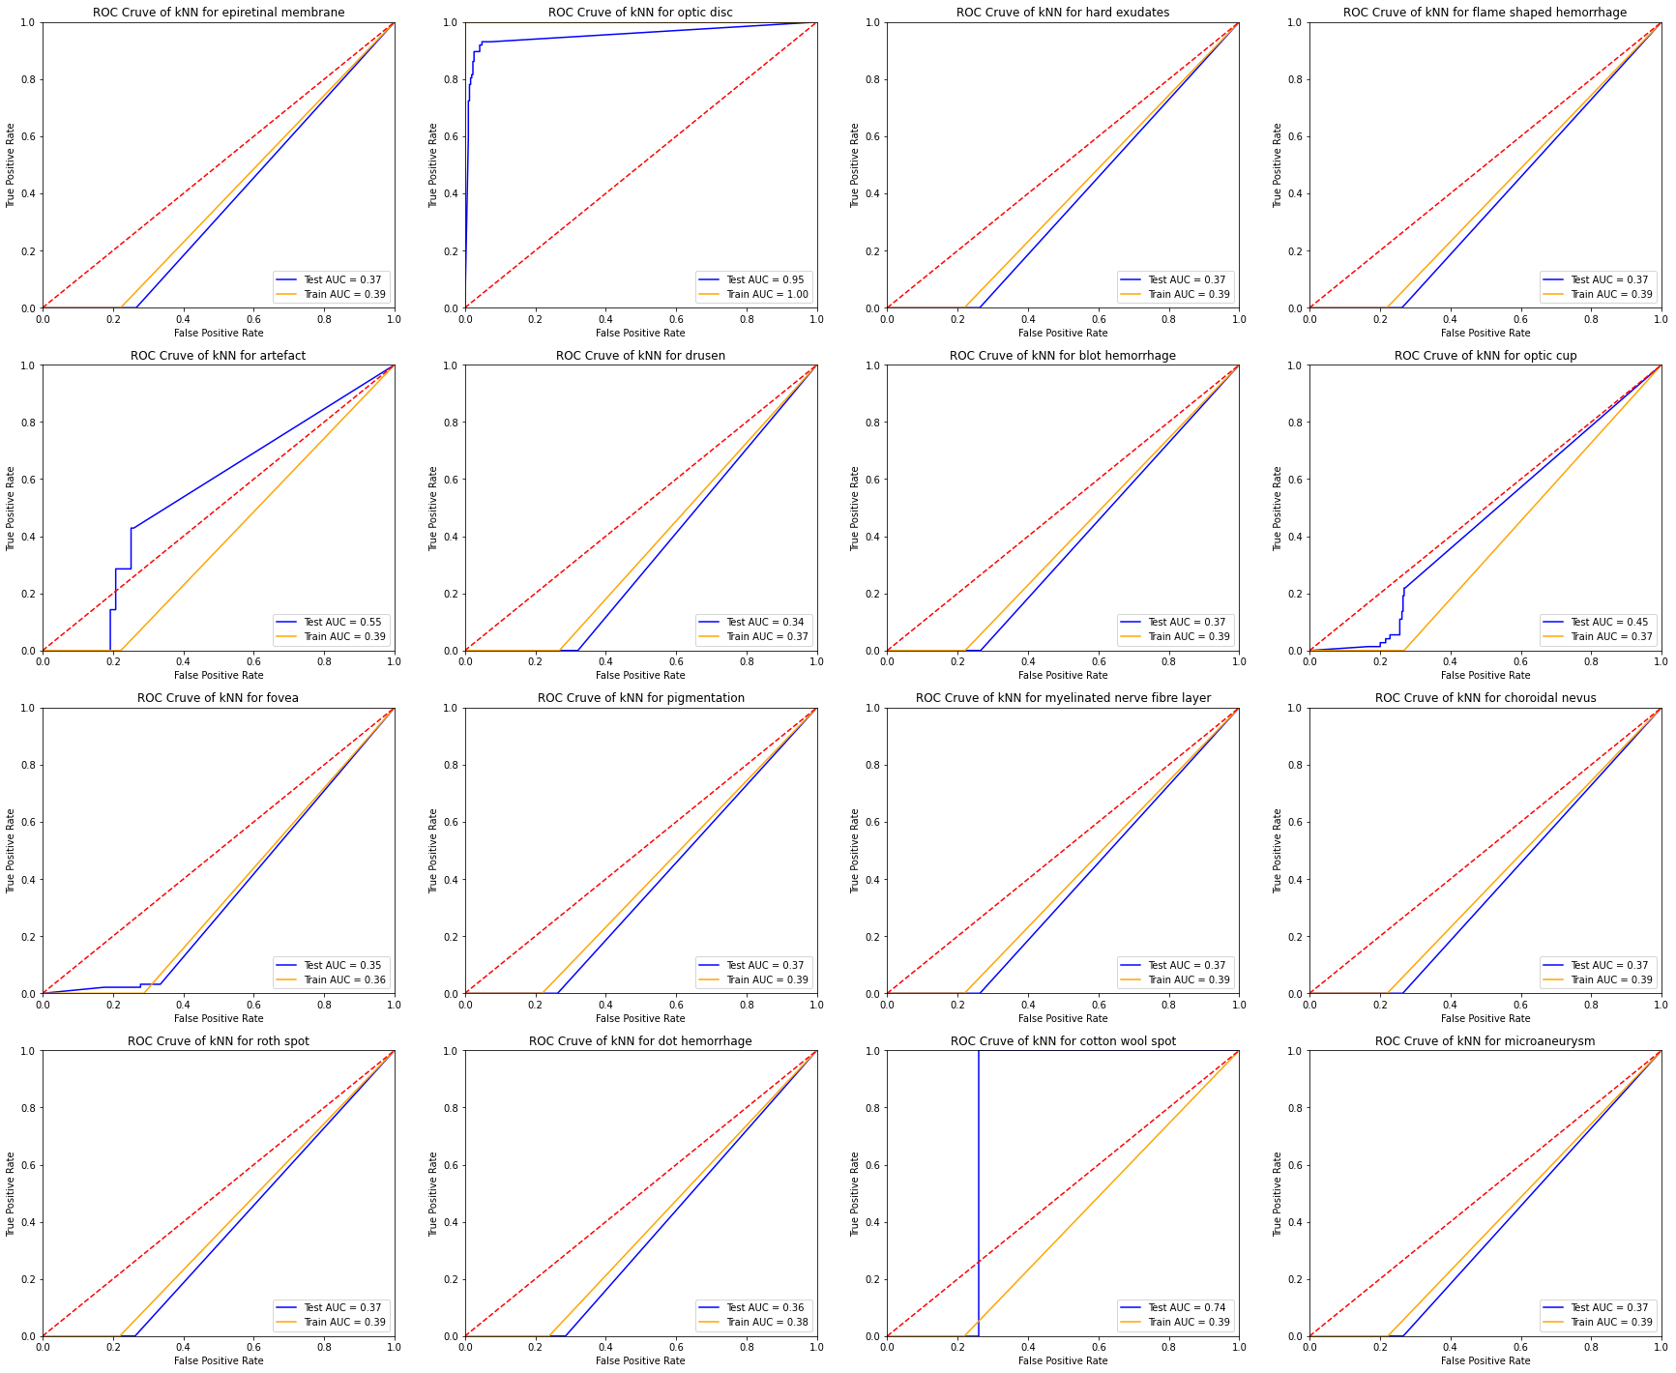
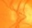
Progress Update
Preliminary result with kNN:
Transform image data into a table matrix
Retain original R,G,B information
Have 16 classes
Using GridSearch to search for optimal hyper-parameters
Best parameters: {'algorithm': 'auto', 'n_neighbors': 3, 'weights': 'distance'}
Accuracy is 74.81108312342569%
This method can best differentiate ”optic disc” (auc=0.95). Other classes performs very badly
kNN may not be a suitable method for differentiation of features in fundus image
Example of optic disc

Slide 21
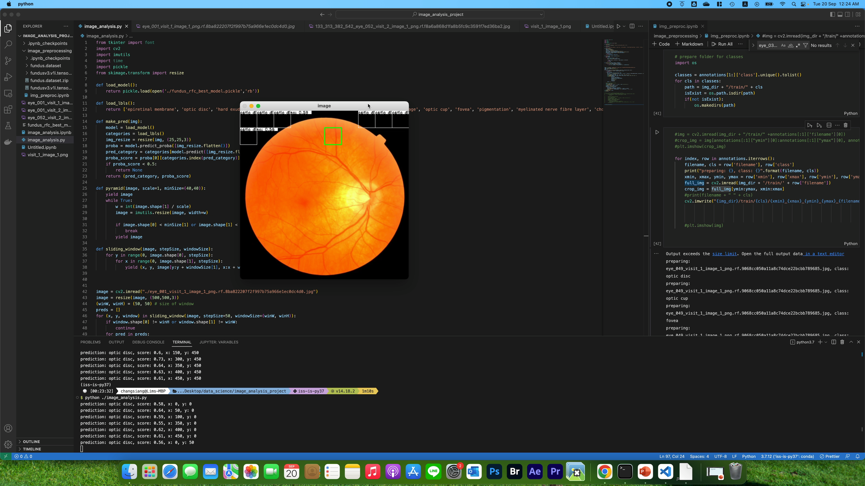
Progress Update
Bounding Box (bbox) detection
First Iteration: Implemented naïve sliding window approach to detect bounding box
Crop section of the image sequentially
Classify each cropped image with ML models
Task: Exploring other bbox detection techniques -> Sliding window too slow

Slide 22
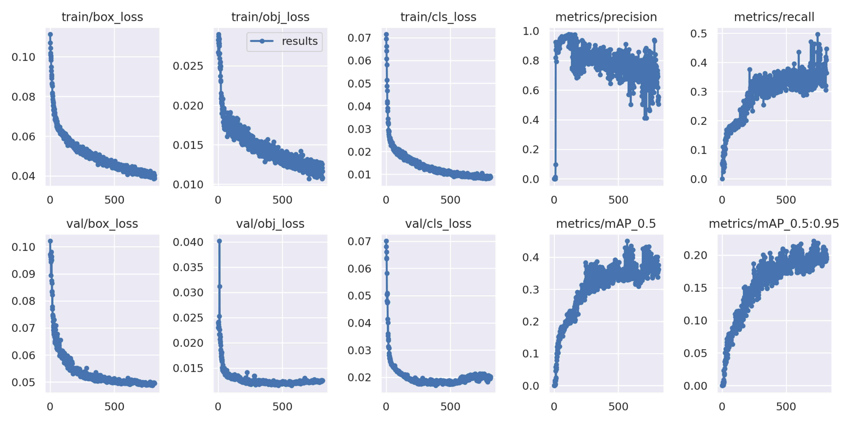
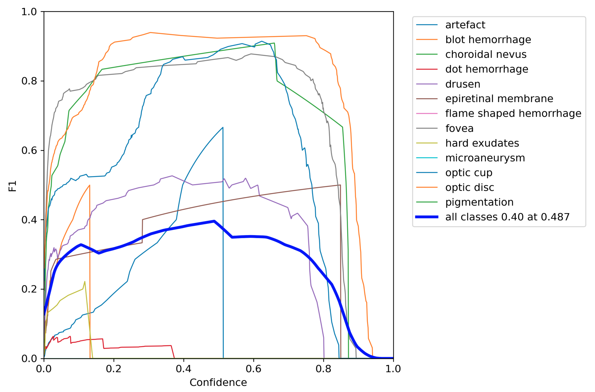
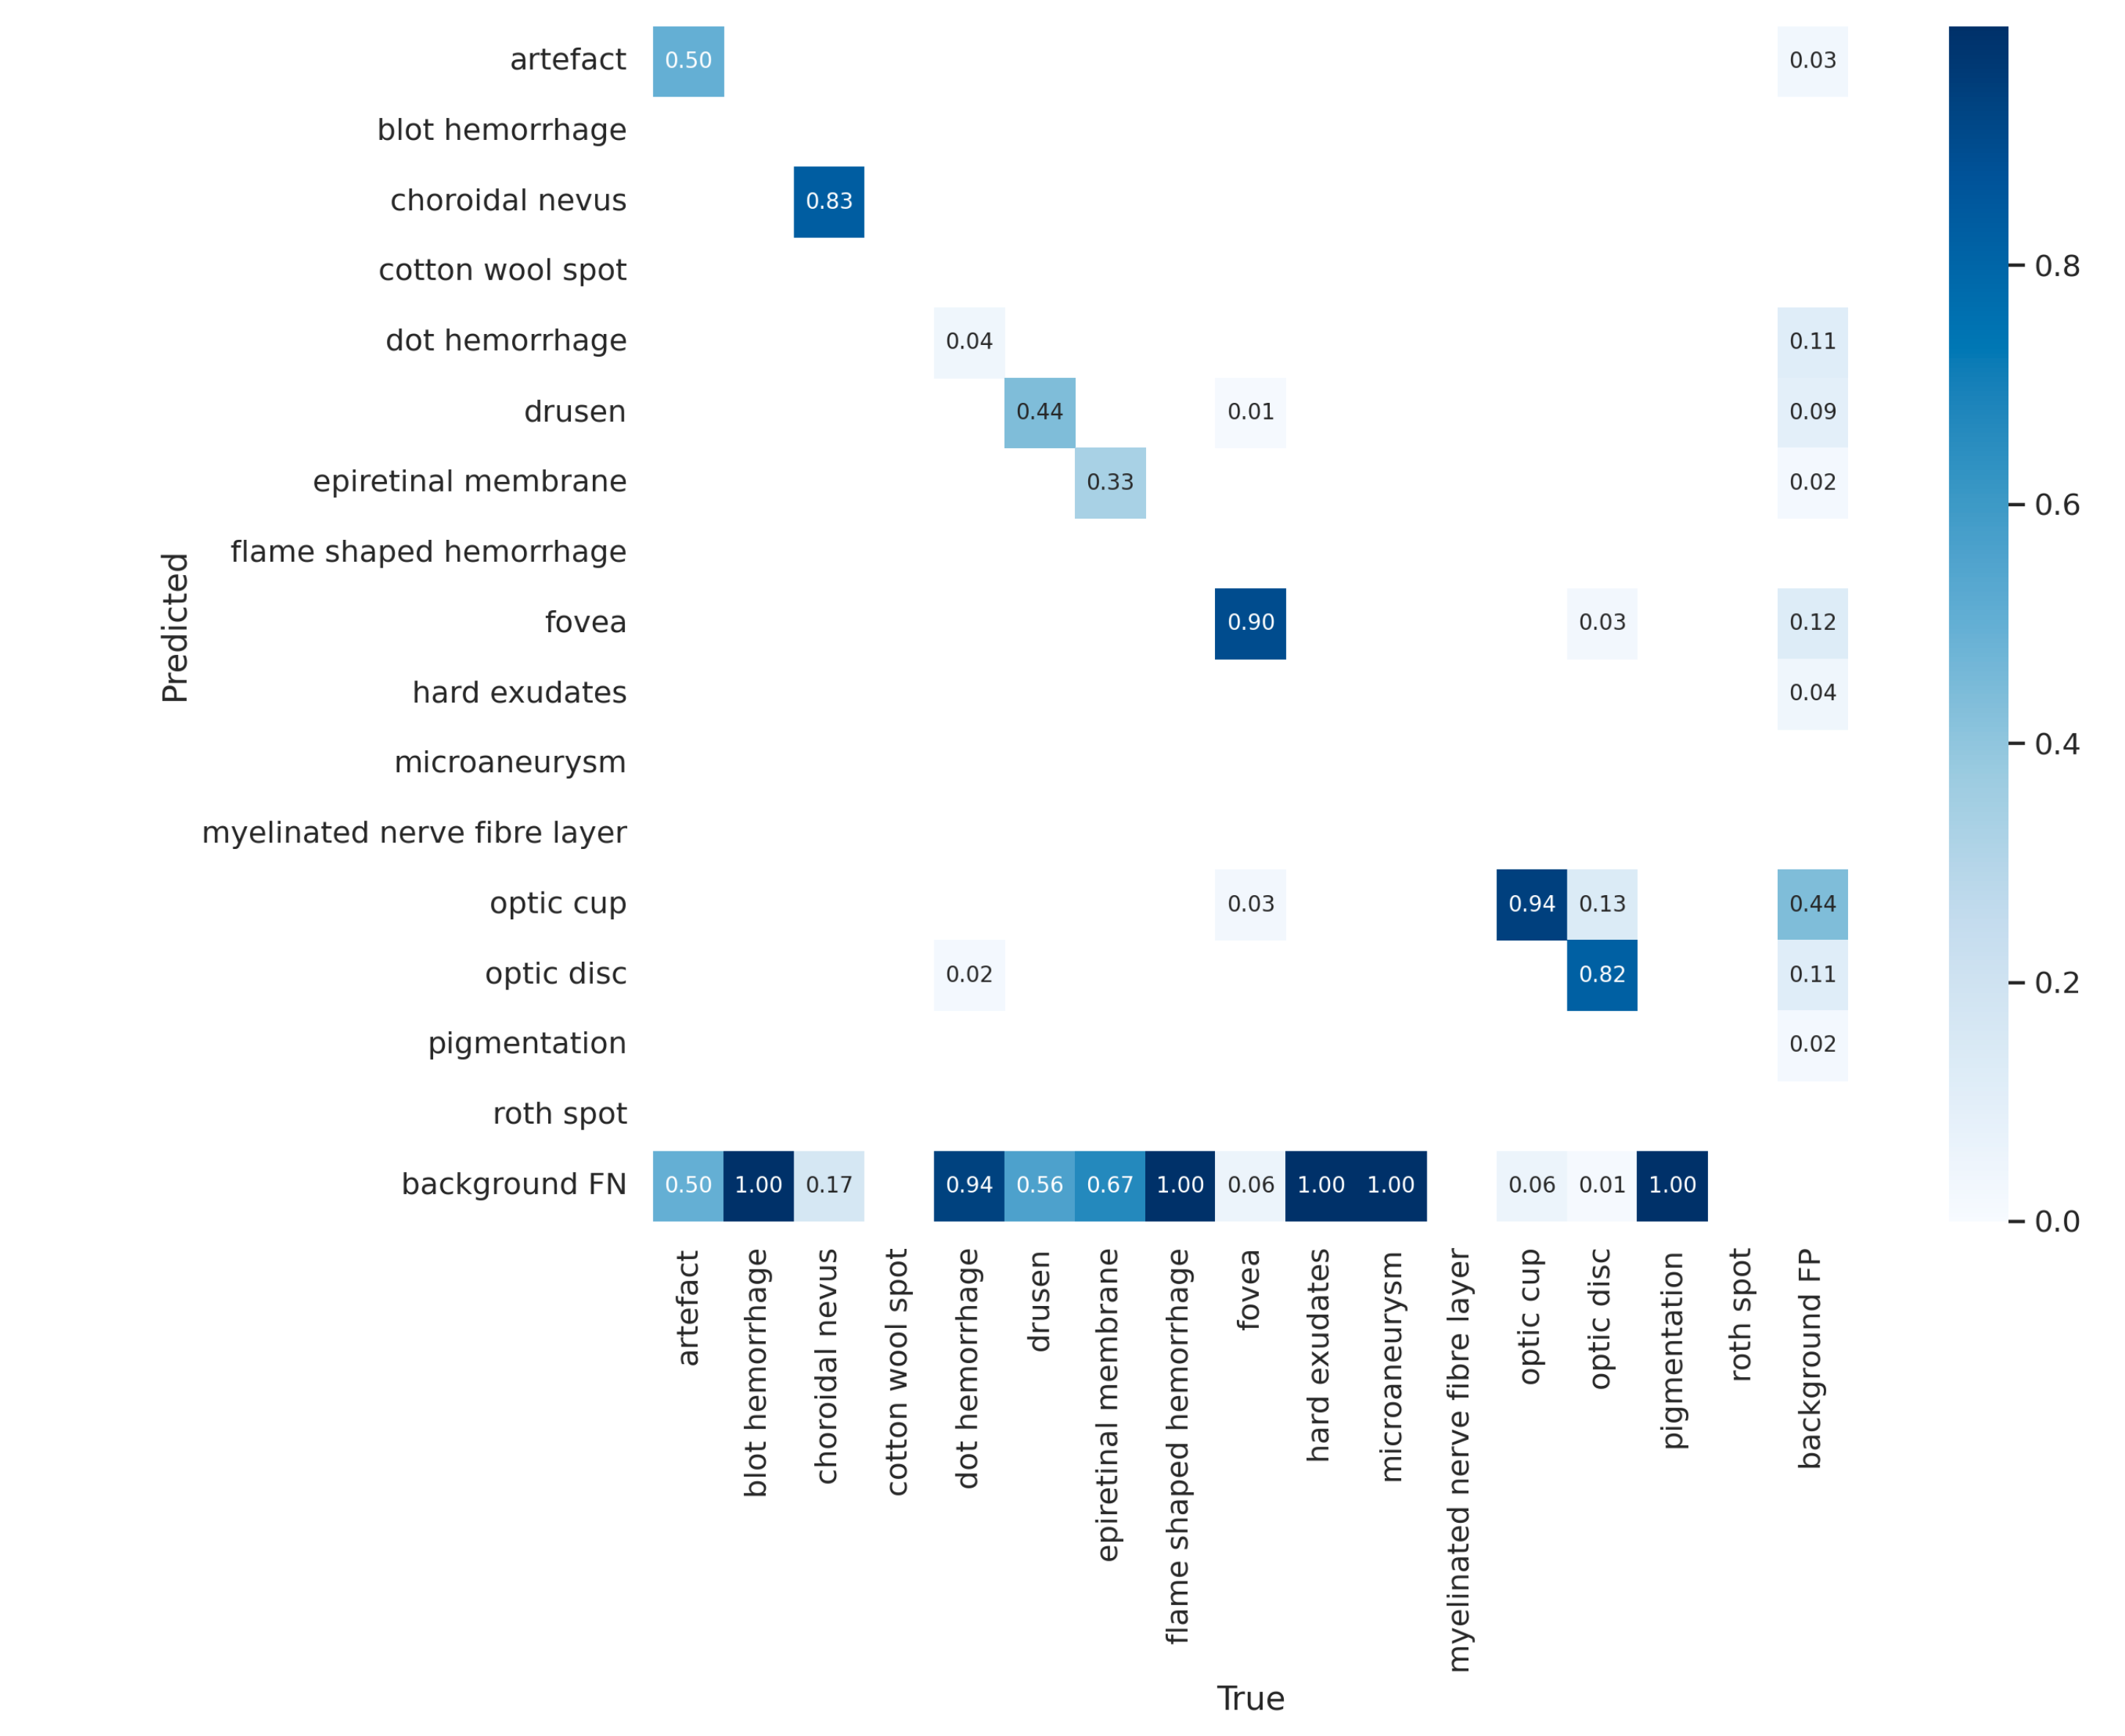
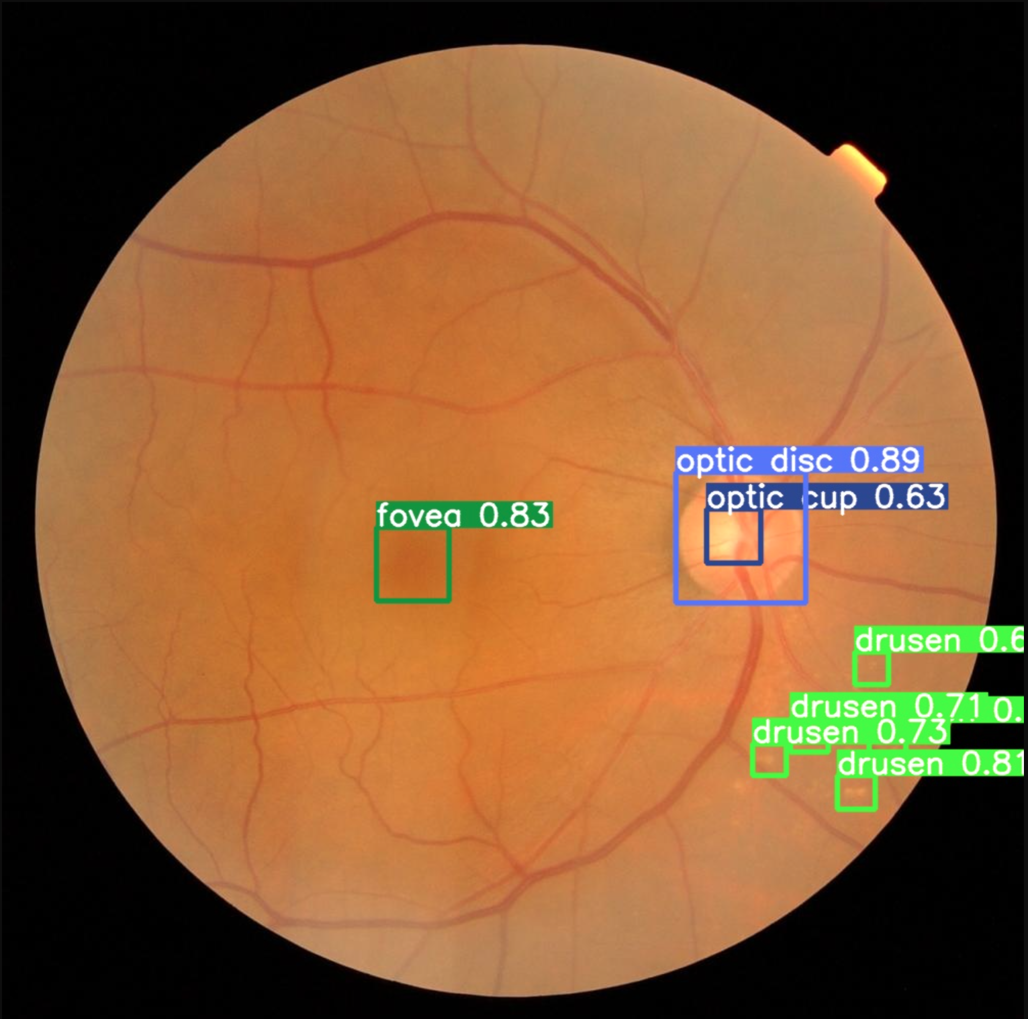
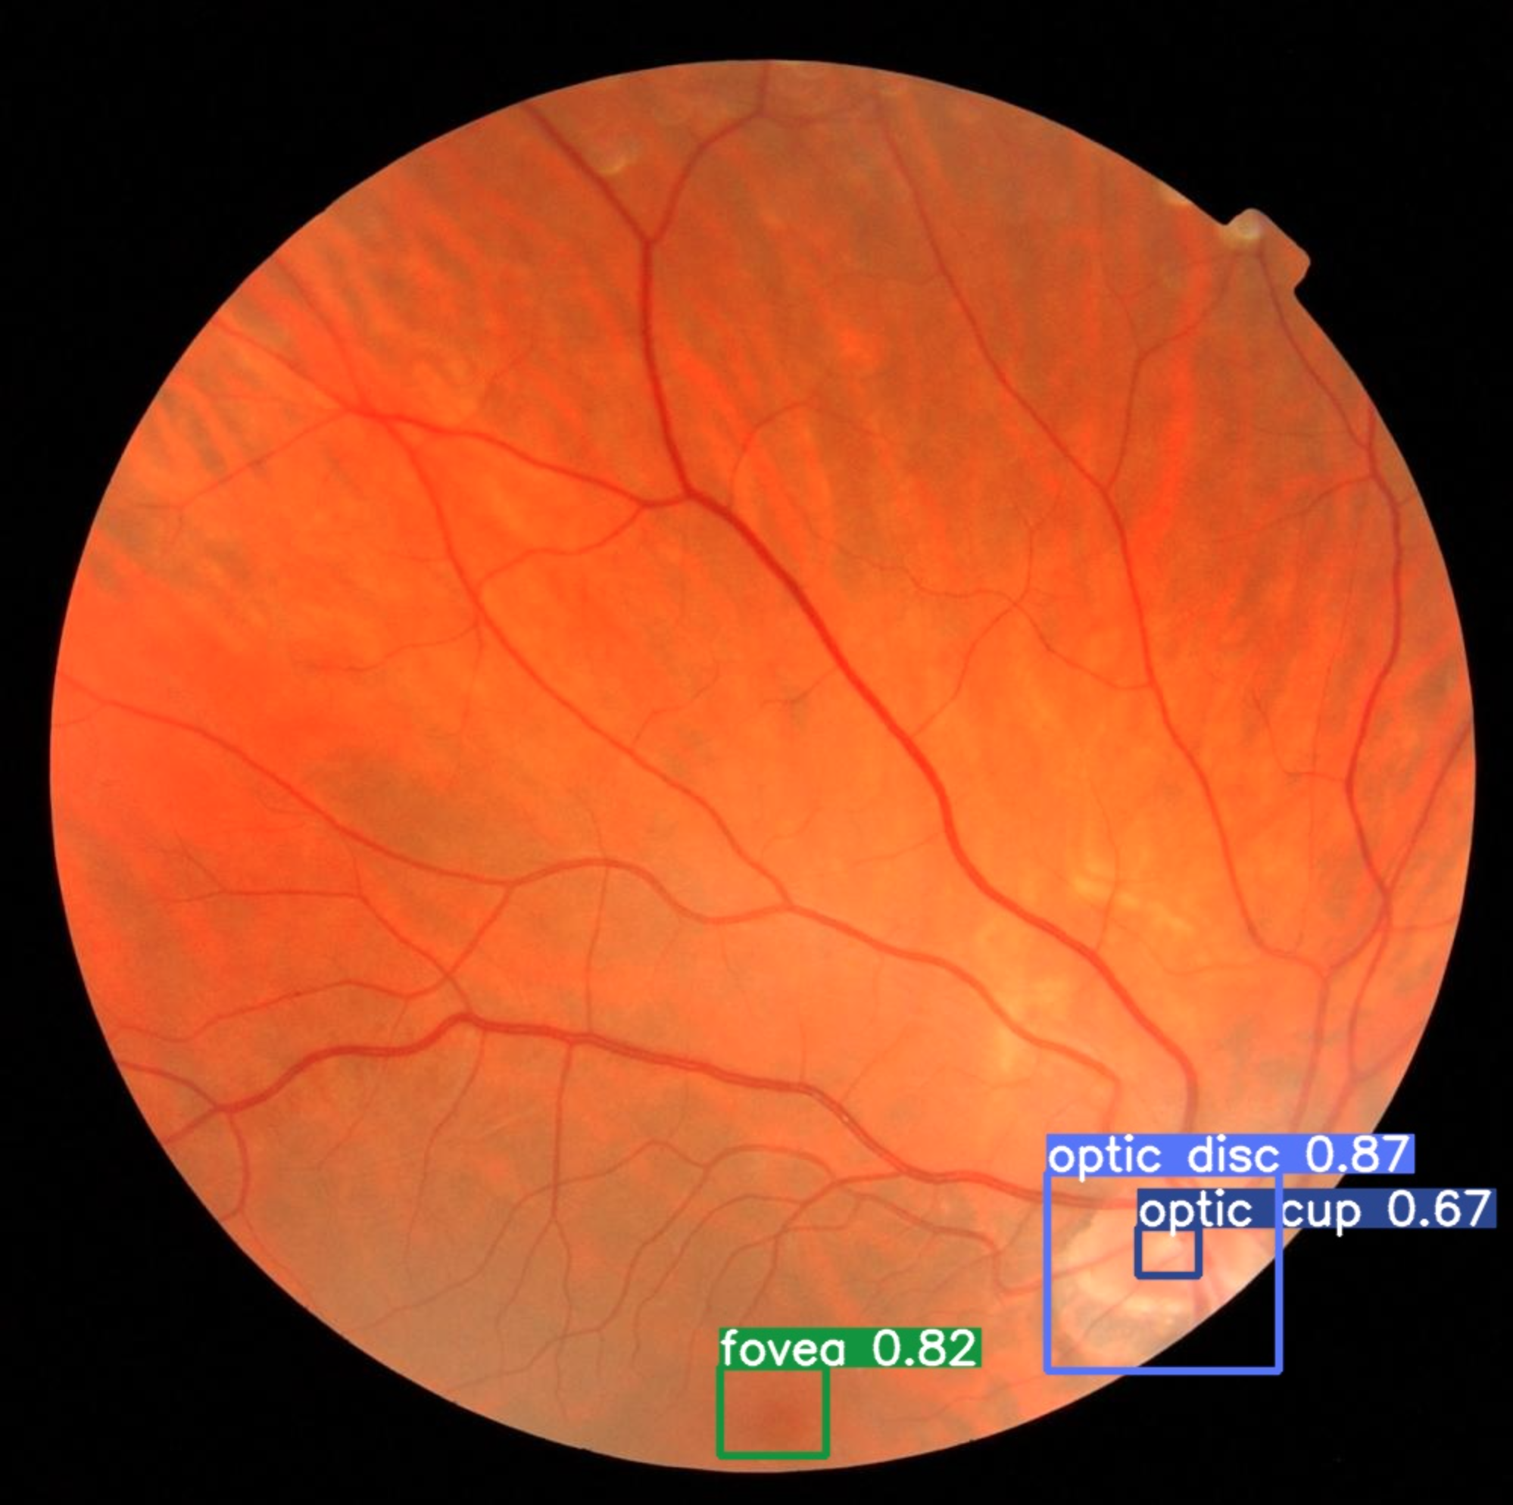
Progress Update
Training and Validation loss
Preliminary result with Neural Network
Attempt using YOLOv5 architecture with transfer learning
Used library from Ultralytics
Transfer learning from model trained using COCO dataset
Model was able to differentiate 4 classes (our of 16 classes)
Optic cup, optic disc, fovea, choroidal nevus
F1 Curve
Confusion Matrix
Example Prediction 1
Example Prediction 2

Slide 23
Summary
Project Proposal submission
Data acquisition and labelling is done
Attempted some Machine Learning and Deep Learning techniques
Need to find address imbalance class issue
Need to explore other bounding box detection approach
Explore more ML and DL techniques
Decide on the final AI architecture
System integration

Slide 24
Thank You!
Do you have any questions?

